Slide 1






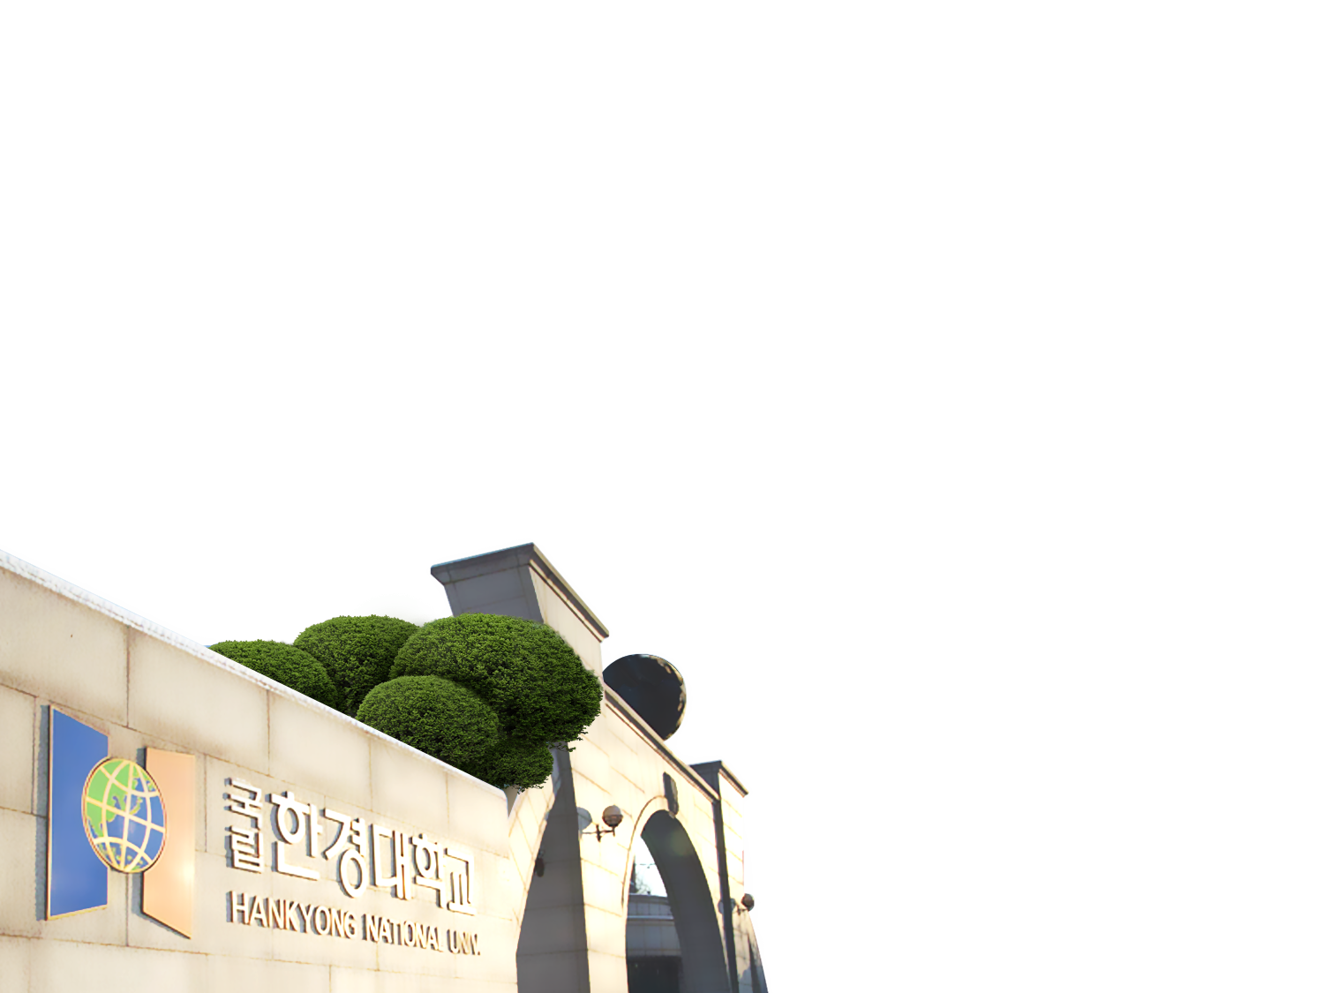


경기도대표, ACE 대학
DoMega - bot
HANKYONG NATIONAL UNIV.

Slide 2





Ⅰ
Demo Video
Ⅱ
Summary
“
”
경기도대표,
ACE
Ⅲ
Configuration
대학
contents
HANKYONG NATIONALUNIVERSITY
Ⅳ
Benefits
Ⅴ
Q&A

Slide 3



01
경기도대표, ACE 대학
Demo Video

Slide 4

02
경기도대표, ACE 대학
Summary
Reason for selection
Motivation
Human activity constraints at disaster scene
Limitations of a single Robotic system
Purpose
Overcoming various areas
Docking and Multi control system

Slide 5
02
경기도대표, ACE 대학
Summary
Solution
Transportation
Center wheel
Two/Four-legged walk
Face detection
Independent exploration
Exploration
Caterpillar
Autonomous driving

Slide 6
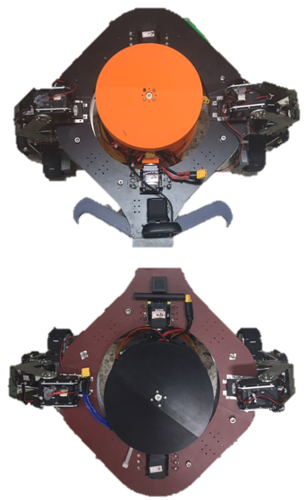
03
경기도대표, ACE 대학
Configuration
Multi Robot Server
Auto Docking by Image Processing
Ultrasonic Sensor
(Auto Driving)
Wheel on Center (Fast move)
Face Detection for Found Injured
Caterpillar (Overcoming Terrain)
Basic plan

Slide 7
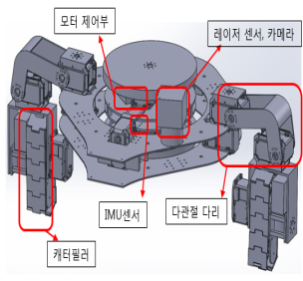
03
경기도대표, ACE 대학
Configuration
Detail Design
Motor control
Laser sensor, Camera
IMU sensor
Articulated leg
Caterpillar

Slide 8
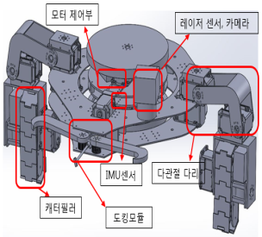
03
경기도대표, ACE 대학
Configuration
Detail Design
Motor control
Laser sensor, Camera
IMU sensor
Articulated leg
Caterpillar
Docking module

Slide 9
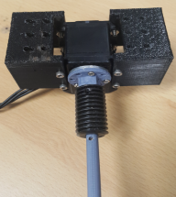
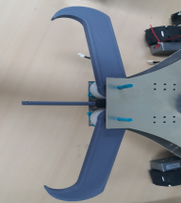
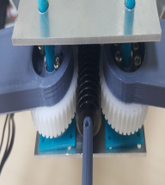
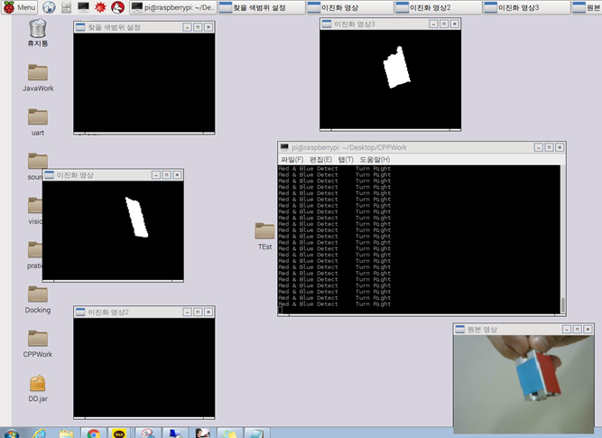
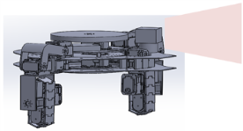
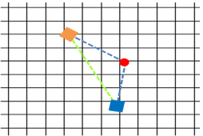
03
경기도대표, ACE 대학
Configuration
Docking Mode
< Worm - Motor >
< Worm – Gear >
< Angle and distance measurement between robots>
< Finding Good Point for Docking >

Slide 10
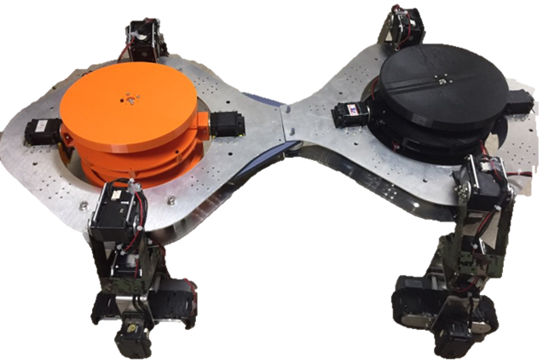
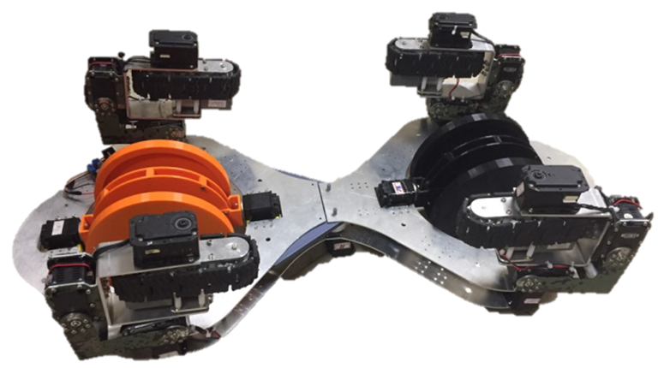
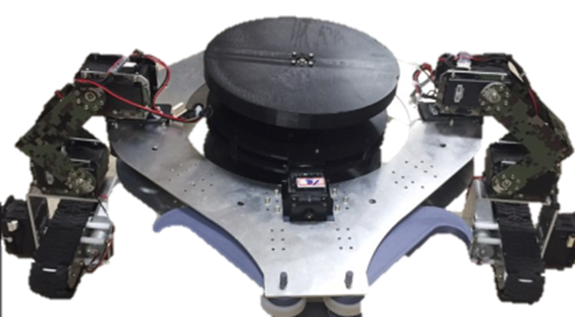
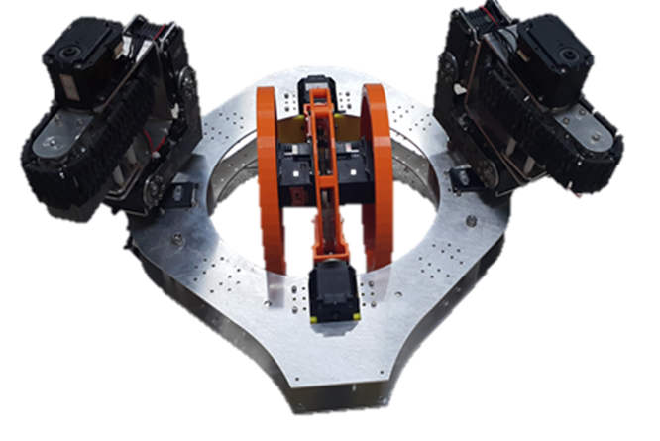
03
경기도대표, ACE 대학
Configuration
Driving Mode
< Docking Caterpillar Mode >
< Docking Wheel Mode>
< Separation Caterpillar Mode >
< Separation Wheel Mode>

Slide 11
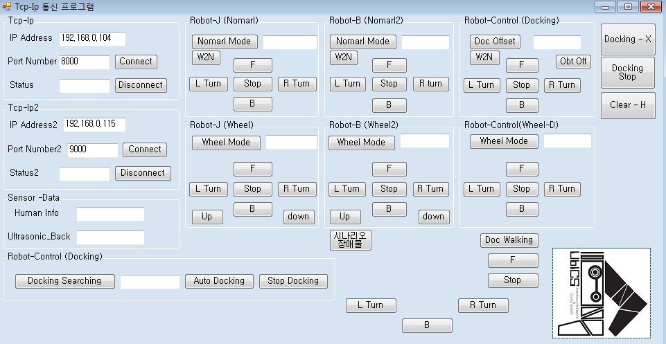
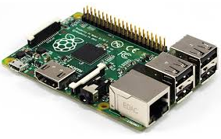
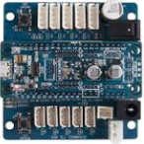
03
경기도대표, ACE 대학
Configuration
Multi Robot Server
< Main Controller >
(Raspberry Pi 3)
< Serve Controller >
(OpenCM 9.04)
< PC C# Multi server >

Slide 12

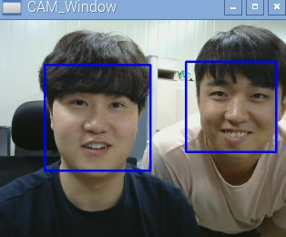
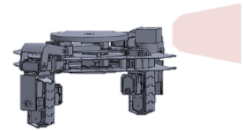

03
경기도대표, ACE 대학
Configuration
Face Detection for Found Injured

Slide 13
04
경기도대표, ACE 대학
Benefits
Benefits
Center wheel
- Designed with a 3D printer to reduce weight, and by attaching wheels
to the center of the robot, maneuverability can be maintained even when
the legs break down.
Caterpillar
- It is possible to walk delicate without a caterpillar-shaped bridge.
- Capable of navigating in harsh terrain and requiring precision in exploration.
Docking
- Taking a docking structure, tasks that one robot can not perform can be
performed faster and in various forms
- Docking status can be detached and sustained if a problem occurs.

Slide 14
05
경기도대표, ACE 대학
Q&A

Slide 15
Thank You
경기도대표, ACE 대학
감사합니다

